Slide 1
Azure Synapse Analytics + Power BI Better Together
<Name>
<Title>
Notes:
Introduction

Slide 2
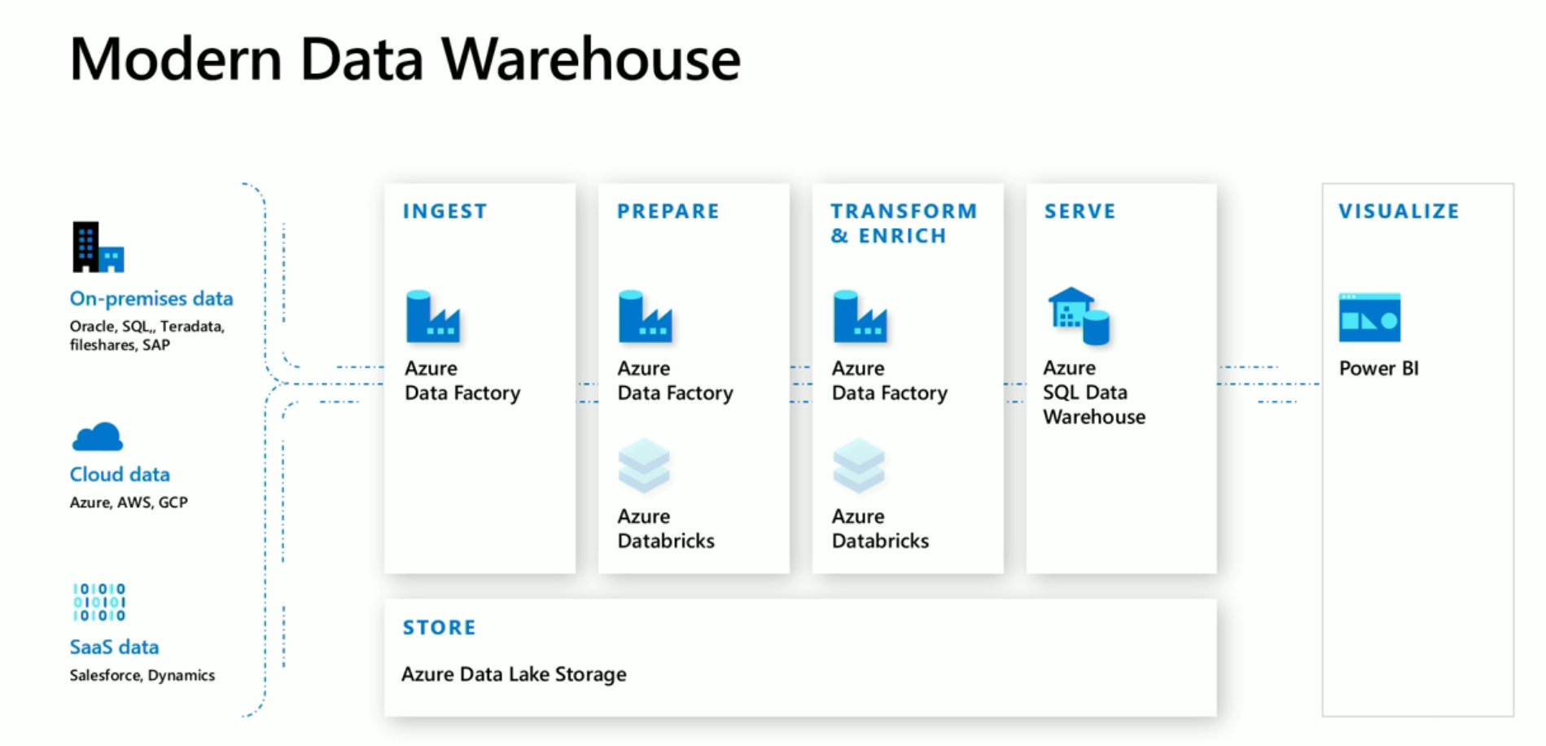
Notes:
Before Synapse, a modern data warehouse will typically consist of a data lake, a ingestion tool, such as azure data factory to bring data in from different sources to data lake, data engineering tools , such as Azure Databricks or Azure Data Factory, to prepare and transform data and store it in a data warehouse as a serving layer for the visualization in Power BI. Azure Data Factory has 90+ connectors, and enables connections to on-premise and cloud data source as well as SaaS solutions.

Slide 3
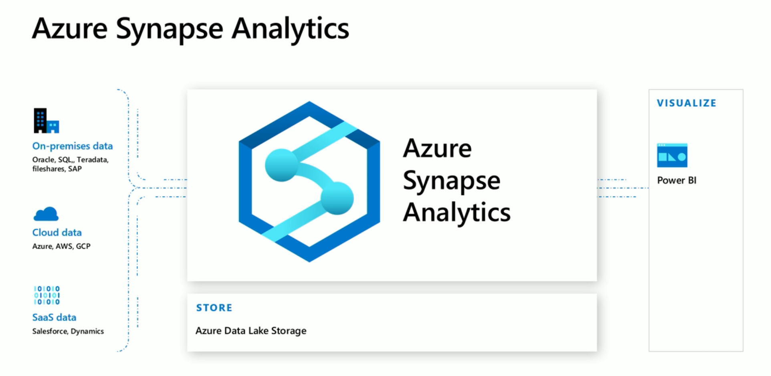
- Data Lakehouse
Notes:
https://www.advancinganalytics.co.uk/blog/2020/2/4/the-data-lakehouse-dismantling-the-hype
https://databricks.com/blog/2020/01/30/what-is-a-data-lakehouse.html
Synapse brings all the capabilities of ingesting and transforming data together within Synapse studio and has the data lake and power BI has linked services, massively simplifying the components needed for a modern data warehouse buildout

Slide 4

Azure Synapse Analytics
Integrated data platform for BI, AI and continuous intelligence
Artificial Intelligence / Machine Learning / Internet of Things
Intelligent Apps / Business Intelligence
Designed for analytics workloads at any scale
Synapse Analytics
SaaS developer experiences for code free and code first
Experience
Azure Synapse Studio
Platform
Multiple languages suited to different analytics workloads
MANAGEMENT
Languages
MANAGEMENT
SQL
Python
.NET
Java
Scala
R
Integrated analytics runtimes available provisioned and serverless on-demand
SQL Analytics offering T-SQL for batch, streaming and interactive processing
Spark for big data processing with Python, Scala, R and .NET
SECURITY
Form Factors
SECURITY
PROVISIONED
ON-DEMAND
MONITORING
Analytics Runtimes
MONITORING
SQL
METASTORE
METASTORE
DATA INTEGRATION
Integrated platform services for, management, security, monitoring, and metastore
Azure
Data Lake Storage
Common Data Model
Enterprise Security
Optimized for Analytics
Data lake integrated and Common Data Model aware
Notes:
To think about Synapse, we start with a data lake. We bring in data from different data sources into the data lake. This is where different types of data are stored, and where we can deal with security in files and folders. It is pivotal to design the structure of the data lake in accordance with business and technical requirement.
Synapse offers a set of integrated platform services that provide you with all the support for management, for security, for monitoring and for metastore. Data integration enables the data ingestion from different data sources into the data lake and the transformation of the data in an orchestrated manner.
Synapse analytics also offers a combination of two of the most powerful analytics run times. On one side, we have SQL, which before synapse analytics was known as Azure SQL data warehouse. This is an MPP, a massive parallel processing platform capable of working huge workloads. On the other side, we have spark, which is the default choice today for big data processing with a variety of languages ranging from Scala,.Net and Python. In Synapse Analytics these two powerful runtimes are available side by side.
Synapse Analytics also introduces 2 different form factors for the SQL runtimes. Users has the option of either using the provisioned SQL runtime called SQL pool, which is the way that we traditionally use Azure SQL data warehouse, or using serverless form factor. Serverless form factor, also called SQL on demand, is a new offering that allows users to run SQL queries over the lake on the fly.
With Synapse, users have a choice of languages of SQL, Python, .Net. Java, Scala, and R. Choice of languages can be made based on team skillset and the workload.
Everything is glued together in Azure Synapse Studio. Azure Synapse Studio is a software as a service offering that provides users the developer experience with both code free and code first approach and is designed for workloads at any scale, be it AI Machine Learnin, IoT, intelligent apps or business intelligence.

Slide 5

Azure Synapse Analytics
Limitless analytics service with unmatched time to insight
Limitless Scale
Powerful Insights
Unified Experience
Unmatched Security
Industry-leading performance on demanding workloads
Integration with Power BI and Azure Machine Learning
Data prep and management, big data, and AI in a single workspace
Fine-grained access controls and layers of protection
Notes:
Azure Synapse is the next evolution of Azure Synapse. It gives data professionals the freedom to query data on their terms, using either serverless on-demand or provisioned resources—at limitless scale. With Azure Synapse we are bringing two divided worlds together—relational data and big data—with a unified experience to ingest, prepare, manage, and serve data for immediate BI and machine learning needs.
With limitless scale in Azure Synapse, you are guaranteed industry-leading performance on your demanding workloads, such as enterprise data warehousing and also use the new serverless on-demand query capability to query your data
And you can deliver powerful insights across your business as Azure Synapse is deeply integrated with Power BI and Azure Machine Learning. This will significantly reduce project development time and enable data professionals to apply intelligence over all their most important data—such as data from Dynamics 365, Office 365, to SaaS services that support the Open Data Initiative.
This is all accomplished with a unified experience where data prep, data management, data warehousing, big data, and AI tasks can be done in a single, unified workspace.
And, of course, security is always paramount. Azure Synapse provides fine-grained access control to ensure data stays safe and private.

Slide 6


Power BI
Import
DirectQuery
Composite Models &
Aggregation Tables
Great for small data sources and personal data discovery
Fine for CSV files, spreadsheet data and summarized OLTP data
The enterprise solution
Avoid data movement
Delegate query work to the back-end source; take advantage of Azure Synapse’s advanced features
Why choose? Import and DirectQuery in a single model
Keep summarized data local; get detail data from the source
Notes:
Power BI has an import mode, for smaller datasets or summarized datasets, users can import the data and have it cached in Power BI for optimal performance
For Large workloads, it is better to avoid moving large volume of data into Power BI. Instead one can take advantage of Synapse’s features and push the compute down to the data warehouse layer by using Direct Query.
In a star schema, typically dimension tables will be smaller and fact tables are larger, users can take advantage of the composite model and also utilize aggregation tables where aggregation tables can be imported, and queries are sent down to data warehouse if details are required.

Slide 7




Azure Synapse performance advantage
Overview
TPC-H 30TB Cloud DW Benchmark
$564
Azure Synapse’s industry leading price-performance comes from leveraging the Azure ecosystem and core SQL Server engine improvements to produce massive gains in performance.
These benefits require no customer configuration and are provided out-of-the-box for every data warehouse
Gen2 adaptive caching – using non-volatile memory solid-state drives (NVMe) to increase the I/O bandwidth available to queries
Azure FPGA-accelerated networking enhancements – to move data at rates of up to 1GB/sec per node
Instant data movement – leverages multi-core parallelism in underlying SQL Servers to move data efficiently between compute nodes
Query Optimization – ongoing investments in distributed query optimization
$152
$103
$110
$40
$33
$47
$54
$48
$51
DW5000C
DW15000C
DW30000C
2X-Large
3X-Large
4X-Large
BigQuery
dc2.8xlarge 10N
dc2.8xlarge 30N
dc2.8xlarge 60N
Azure Synapse
Snowflake
Google
Redshift
TPC-DS 30TB Cloud DW Benchmark
$1310
$570
$286
$206
$309
$153
Azure Synapse
Amazon Redshift
Snowflake Standard
Snowflake Enterprise
Google BigQuery Flat Rate
Google BigQuery Per Byte
Notes:
In these two industry standard benchmark reports published, Synapse was found to have the best price-performance out of its competitors

Slide 8

Demo1 Performance of Power BI on Synapse

Slide 9
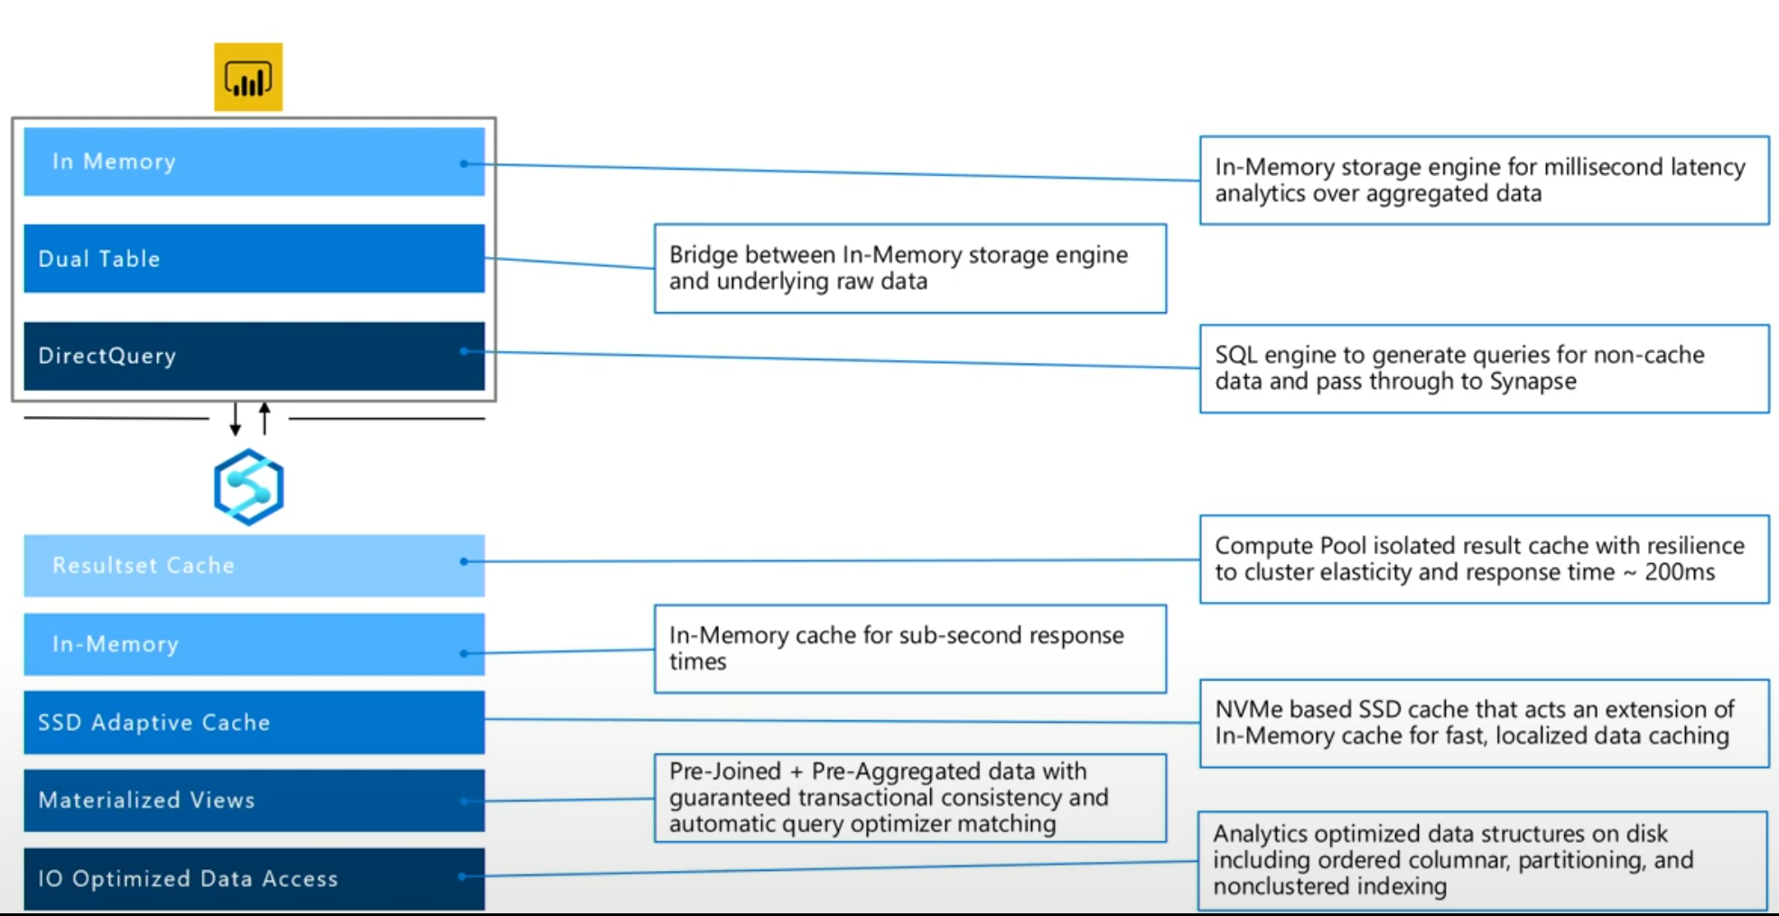
Multi-Tier caching for economical performance
Notes:
As seen in the demo, when rendering a visual, power BI will look for the underlying data in the in memory storage first, if the data is not found, it will generate queries for non-cache data and pass through to Synapse. Some tables could be in dual mode, so that the users can take advantage of both worlds.
When query hits Synapse, it will first determine whether the query result exist in resultset cache, when a query is run, the resultset is cached in Synapse for 48 hours and all the runs on the same query following that will hit the resultset cache instead. The response time for resultset cache is ~200ms
Materialized views are pre-computed views that guarantee transactional consistency. Synapse is also smart enough to point a query to materialized view even if the query is against the base table. In Ignite 2020, we announced Usage-based optimization with Azure Synapse and Power BI, which analyses usage patterns in Power BI and shares the information with Synapse to improve query performances. Synapse automatically creates a materialized view optimized for Power BI users — greatly accelerating the speed of a query performance.
Synapse also has In Memory and SSD cache. Synapse will monitor the queries, and frequently-used data will be cached.
If the query needs access to the data that is not existent in resultset cache, materialized views, or in memory and SSD cache, synapse will then read the data from base layer, which has features like ordered columnar, partitioning and nonclustered indexing which is optimizing data structure for analytics workload.

Slide 10
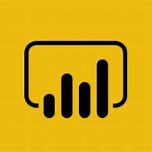




SQL Serverless
Overview
An interactive query service that provides T-SQL queries over high scale data in Azure Storage.
Benefits
Serverless
No infrastructure
Pay only for query execution
No ETL
Offers security
Data integration with Databricks, HDInsight
T-SQL syntax to query data
Supports data in various formats (Parquet, CSV, JSON)
Support for BI ecosystem
Curate and transform data
Power BI
SQL On Demand Query
Azure Data Studio
Sync table definitions
Read and write
data files
SSMS
Read and write
data files
10
01
Azure Storage
Notes:
SQL on demand is a new offering that synapse brings to the market. It is serverless offering with no need to provision for infrastructure. It allows users to run T-SQL query over the data lake on the fly to do exploratory data analysis without having to build a ETL pipeline to move the data into data warehouse first. It can query various data formats including parquet, CSV and JSON. Next demo will show how to use SQL On-Demand and PowerBI together to query parquet files in the data lake directly.

Slide 11
Demo2 SQL Serverless and Power BI

Slide 12
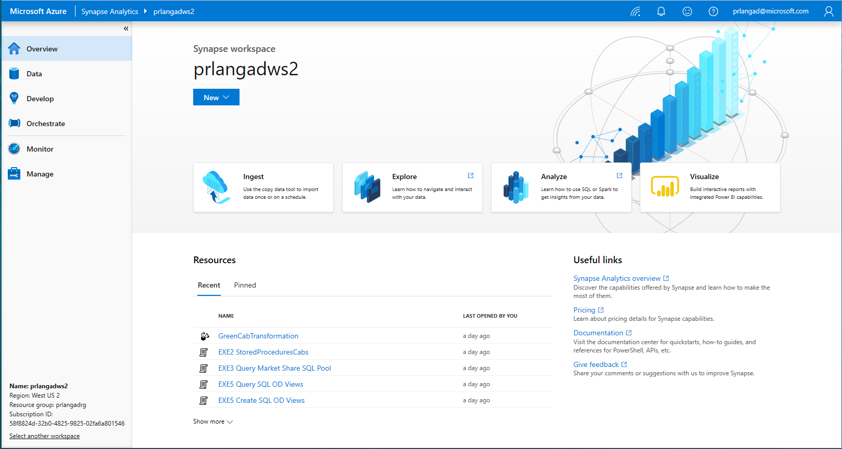
Studio
A single place for Data Engineers, Data Scientists, and IT Pros to collaborate on enterprise analytics
Notes:
All platform services are consolidated together within Synapse Studio. In the single studio experience, you will be able to manage the ingestion, exploration, analysis and visualization of the data. Different hubs on the left-hand side lets the users manage different artifacts. In Data hub, users can access data within synapse as well as data in linked services. In develop hub, users can create, view and manage SQL scripts, notebooks, data flows and Power BI reports. In Orchestrate hub, users are able to manage pipelines. In monitor hub, users can monitor different runs in orchestration and activities in both spark and SQL world. In manage hub, users can manage their SQL and spark pool as well as linked service, triggers and integrations runtimes and last but not least security features.

Slide 13
Demo3 Power BI Report Authoring in Synapse Workspace

Slide 14


Power BI + Azure Synapse Analytics
Industry leading combination for Enterprise Business Intelligence in the Cloud
Azure Synapse
Power BI
Performance
In-Memory
Security
DirectQuery
Workload Management
Composite Models
Notes:
Aside from performance, two other features in Synapse will make Synapse + power BI the leading combination in the industry. In the next few slides, we will cover the unmatched security features in synapse and how workload management feature in Synapse can change user experience in Power BI

Slide 15
Complete security
Category | Feature | Azure Synapse
Data Protection | Data In Transit | Yes
 | Data encryption at rest (Service & User Managed Keys) | Yes
 | Data Discovery and Classification | Yes
Access Control | Native Row Level Security | Yes
 | Table and View Security (GRANT / DENY) | Yes
 | Column Level Security | Yes
 | Dynamic Data Masking | Yes
Authentication | SQL Authentication | Yes
 | Native Azure Active Directory | Yes
 | Integrated Security | Yes
 | Multi-Factor Authentication | Yes
Network Security | Virtual Network (VNET) | Yes
 | SQL Firewall (server) | Yes
 | Integration with ExpressRoute | Yes
Threat Protection | SQL Threat Detection | Yes
 | SQL Auditing | Yes
 | Vulnerability Assessment | Yes
Notes:
Out of all security features, it is worth noting that Synapse offers fine-grained access controls to ensure data is safe and secure. With the availability of native row and column level security, it practically gives users cell level security.
Row-Level Security enables you to implement restrictions on data row access. For example, ensuring that workers can access only those data rows that are pertinent to their department, or restricting a customer's data access to only the data relevant to their company. The access restriction logic is located in the database tier rather than away from the data in another application tier. The database system applies the access restrictions every time that data access is attempted from any tier. This makes your security system more reliable and robust by reducing the surface area of your security system.
Column-Level Security (CLS) is useful when certain columns of a data tables should be only accessed by a restricted group of users. For instance, a financial services firm allows only account managers to have access to customer social security numbers (SSN), phone numbers, and other personally identifiable information (PII) or a health care provider allows only doctors and nurses to have access to sensitive medical records while not allowing members of the billing department to view this data. A query is rejected if it violates permission policy on CLS
Dynamic data masking limits sensitive data exposure by masking it to non-privileged users. Dynamic data masking helps prevent unauthorized access to sensitive data by enabling customers to designate how much of the sensitive data to reveal with minimal impact on the application layer. It’s a policy-based security feature that hides the sensitive data in the result set of a query over designated database fields, while the data in the database is not changed.

Slide 16
Demo4 Security

Slide 17




Workload Management
Workload Importance
Scheduler Without Importance
CEO
CEO
CEO
1
2
3
9
4
5
10
6
7
8
10
9
11
12
10
11
12
Running
Queued
Queued
Queued
By default, workloads are run on a first-in first-out basis.
Notes:
With Synapse, you can set workload importance through workload classification to improve user experience, without importance setting, scheduler will work on first in first out basis. In this example, request 1-8 are running, and request 9-12 are queued, with CEO at the end of the queue, without importance, when request no.3 finishes, request 9 will start, at this point, CEO is growing impatient, then request 5 finishes, request 10 will start, this can make CEO really unhappy because he has waited for too long for an importance financial dashboard to load. Lets see how it would with workload importance in place. (click)

Slide 18

Workload Management
Workload Importance
CREATE WORKLOAD CLASSIFIER classifier_name
WITH
(
WORKLOAD_GROUP = 'name’ ,
MEMBERNAME = 'security_account' [ [ , ]
IMPORTANCE = { LOW | BELOW_NORMAL | NORMAL (default) | ABOVE_NORMAL | HIGH }])
Scheduler With Importance Turned On
CEO
CEO
1
2
3
12
4
5
6
7
8
9
10
11
12
Normal
Low
Normal
High
Running
Queued
Queued
Notes:
Now we set CEO up as high importance through workload classification, as soon as request 3 finishes, CEO’s request will be the next one start running as his request has the highest importance out of all the queued requests.

